Slide 1
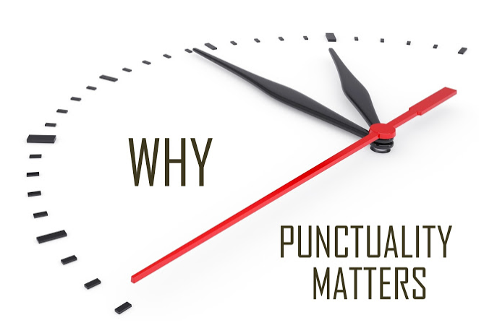
Airlines and Airports Punctuality Performance Analysis
By
Parag Siddamsettiwar
Abhishek Upadhayay

Slide 2
Why is this important?
In today’s busy world, time is a very precious commodity.
Flights are the most convenient and fastest way to travel.
More and more people are taking flights and according to IATA around 8.2 billion people will be travelling by flights in 2037. [1]
Flight delays and cancellations are a major cost escalator for passengers and Airlines.

Slide 3
Why is this important?
In today’s busy world, time is a very precious commodity.
Flights are the most convenient and fastest way to travel.
More and more people are taking flights and according to IATA around 8.2 billion people will be travelling by flights in 2037. [1]
Flight delays and cancellations are a major cost escalator for passengers and Airlines.

Slide 4

In 2010, passengers lost as much as $16.7 billion due to schedule buffer, delayed flights, flight cancellations and missed connections. [2]
According to a research an average Briton wastes 16 days of their holiday time waiting for their flight to take off. [3]

Slide 5
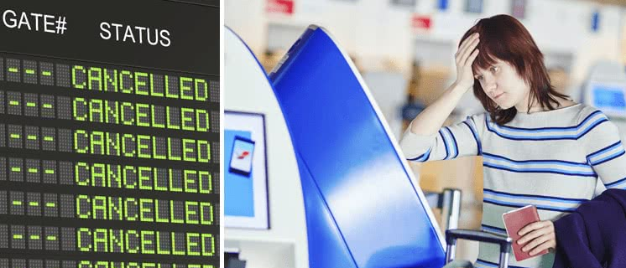

Remember the time when your flight was delayed or cancelled?
It will really help if we can visualize past flight data to get a better understanding of airlines and airports performance to make an informed choice before finalizing our travel plans.

Slide 6
Remember the time when your flight was delayed or cancelled?
It will really help if we can visualize past flight data to get a better understanding of airlines and airports performance to make an informed choice before finalizing our travel plans.

Slide 7






Existing analysis and visualizations
Most of the websites related to airlines and airports are travel booking websites, which only focus on seat availability and ticket prices.
There are handful of websites that provide an analysis on punctuality of airlines and airports.
Even the ones that are available are either on current data (real time or past few hours) and not an analysis on historical data for a proper analysis of trends or behavior.

Slide 8
Existing analysis and visualizations
Most of the websites related to airlines and airports are travel booking websites, which only focus on seat availability and ticket prices.
There are handful of websites that provide an analysis on punctuality of airlines and airports.
Even the ones that are available are either on current data (real time or past few hours) and not an analysis on historical data for a proper analysis of trends or behavior.

Slide 9
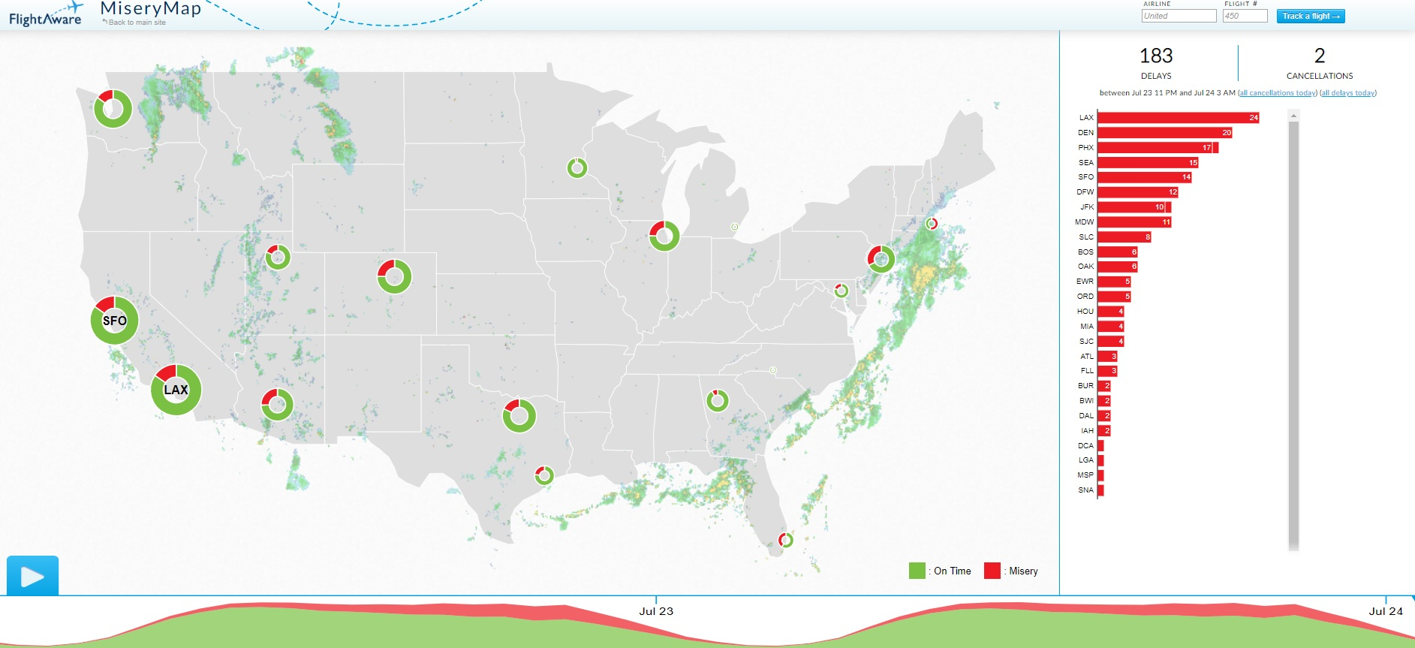
Flight aware flight delay visualization, MiseryMap 2019. [4] This visualization shows some big Airports only, no data available for Airlines and no option to choose other airports e.g. Indianapolis , Cincinnati etc. More importantly , this is based on current data (last few hours) and not an analysis on a historical dataset.

Slide 10
Flight aware flight delay visualization, MiseryMap 2019. [4] This visualization shows some big Airports only, no data available for Airlines and no option to choose other airports e.g. Indianapolis , Cincinnati etc. More importantly , this is based on current data (last few hours) and not an analysis on a historical dataset.

Slide 11
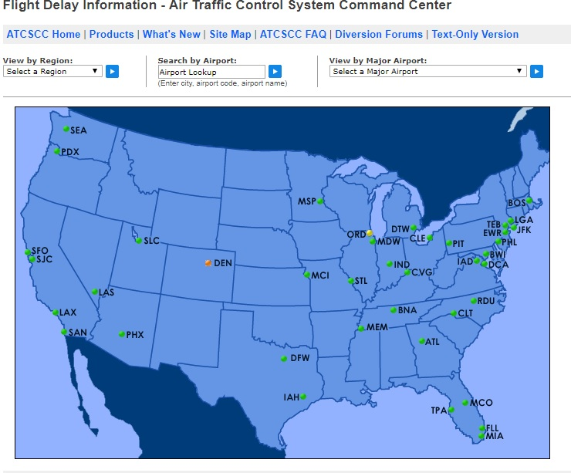
Flight Delay Information - Air Traffic Control System Command Center, 2019. [5] This visualization also shows airports and its also based on current data (last few hours) and not an analysis on a historical dataset. Its interactive and lets user select airport or flights and provides current situation for that.

Slide 12
Flight Delay Information - Air Traffic Control System Command Center, 2019. [5] This visualization also shows airports and its also based on current data (last few hours) and not an analysis on a historical dataset. Its interactive and lets user select airport or flights and provides current situation for that.

Slide 13
Are these visualizations enough?
There is not enough detail available that can help us in planning future travels from airports and airlines based on past trends and airlines behavior.
Even though a flight may show on time on these “current data” visualizations, its possible some of the airlines are regularly late when we analyze complete data.

Slide 14
Objectives
Analyze past years data to compare various airlines and airports based on punctuality.
Create a series of visualizations in order to help a traveler find best choices of carrier and airports in terms of punctuality and certainty.
Visualizations should be easy to understand and pleasing to eyes.

Slide 15
Objectives
Analyze past years data to compare various airlines and airports based on punctuality.
Create a series of visualizations in order to help a traveler find best choices of carrier and airports in terms of punctuality and certainty.
Visualizations should be easy to understand and pleasing to eyes.

Slide 16
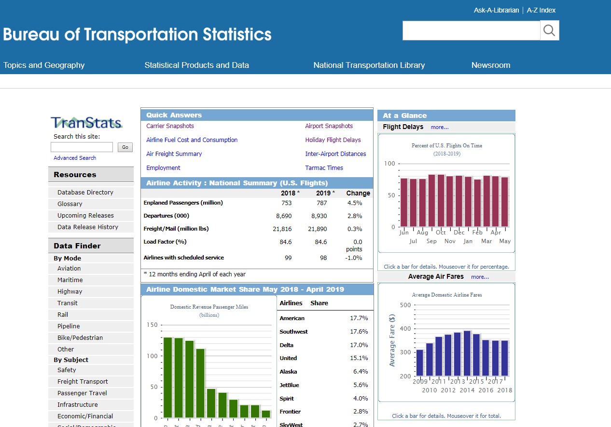
Dataset

Slide 17
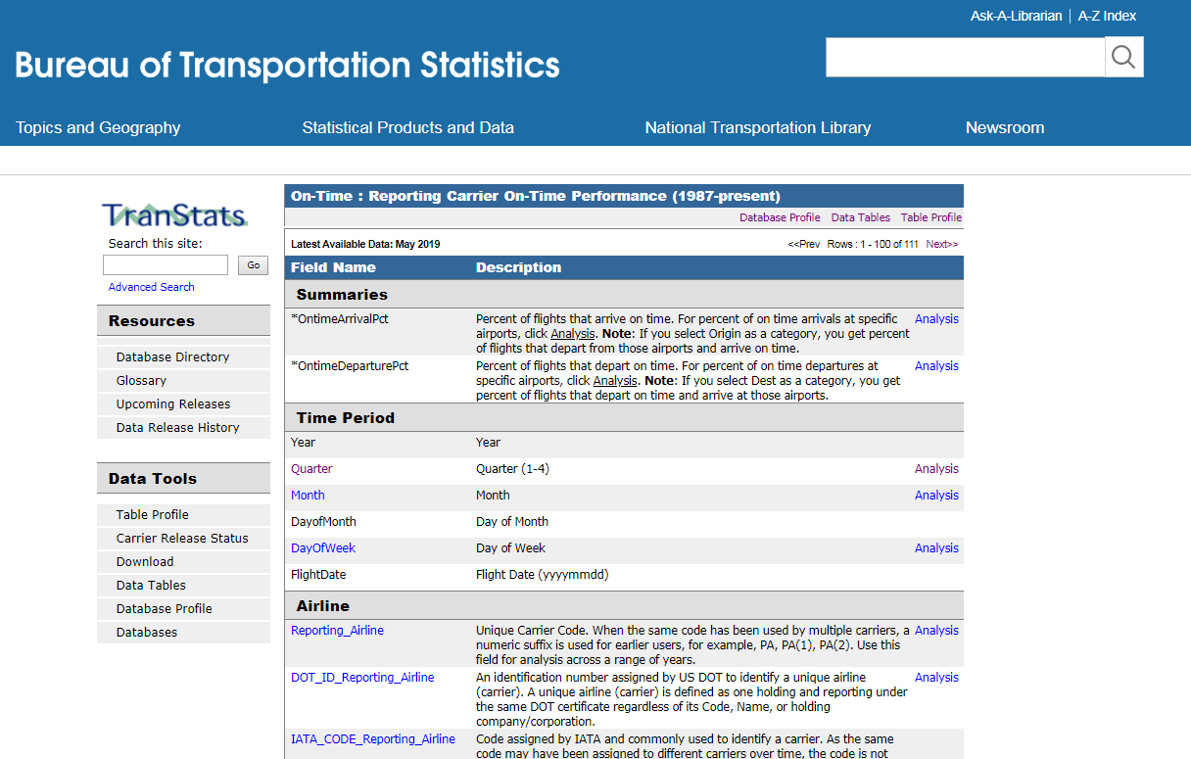
Dataset[6]

Slide 18
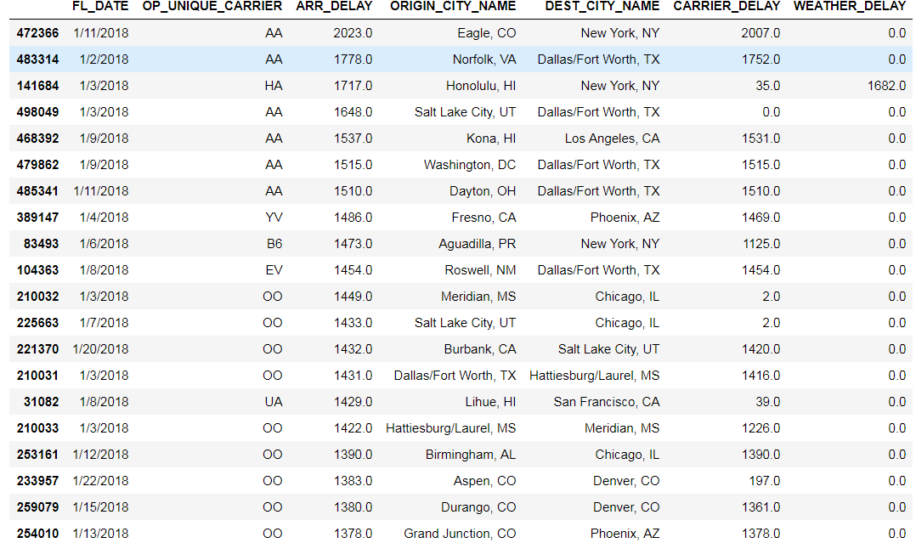
Top 20 delayed flights
The most delayed flight was of American Airlines, which was more than 2000 minutes delayed, almost 1.5 days.

Slide 19
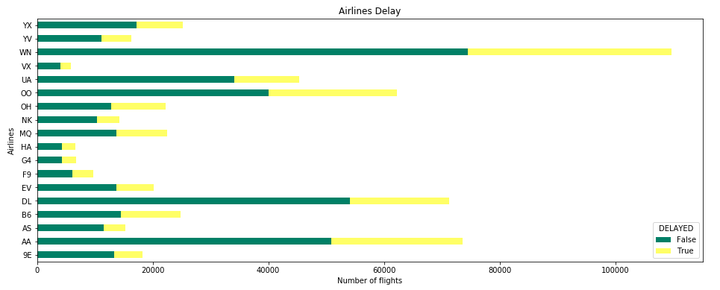
On time vs delayed ratio of flights per airline
Southwest Airlines(WIN) had the highest number of flights in a month of January. All airlines had arrival delay.

Slide 20
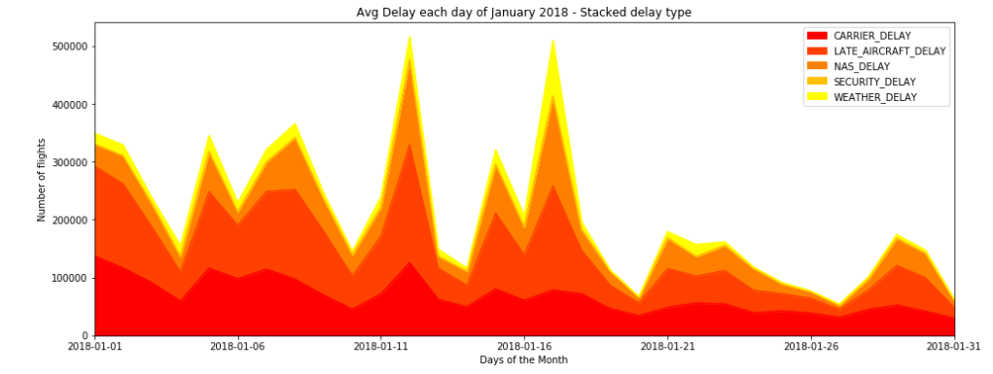
Flight delay reason heat map

Slide 21
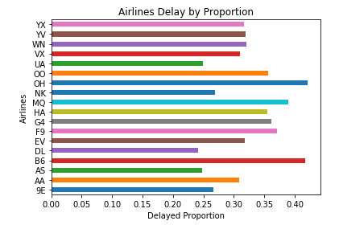
Airline carrier delays proportion
Clearly the ones that looked like had more delays are actually better when compared with proportions. Like Southwest (WIN) and Delta(DL)

Slide 22
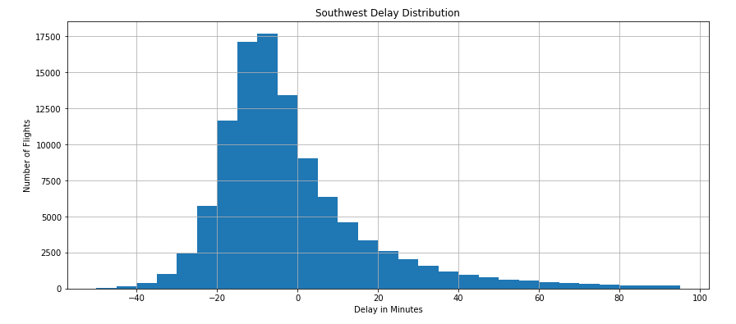
Southwest delay distribution
Looks like southwest is mostly arrives before time or on time even during January's stormy winters.

Slide 23
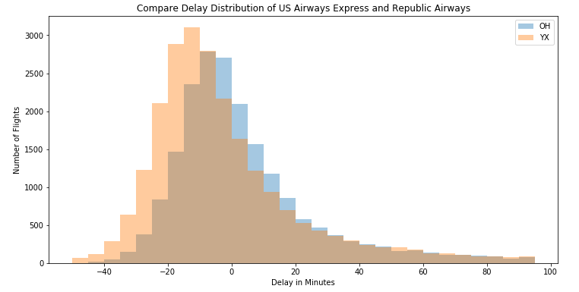
Comparing delay distribution of US Airways & Republic Airways

Slide 24
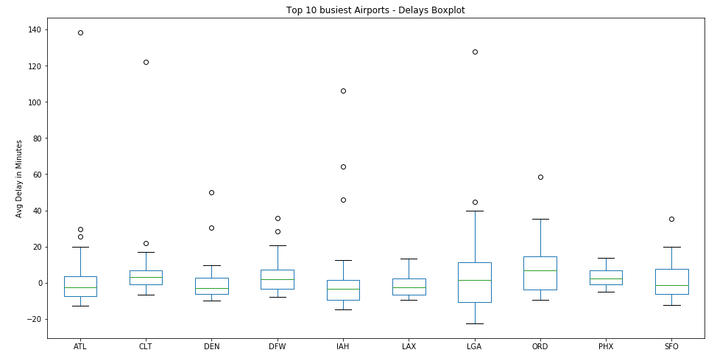
Top 10 Busiest airports and their delays
While other airports delays are evenly distributed around 0, we can see clear dispersion in data at Laguardia NYC and Ohare' Chicago. Based on 2018 data, we can say that try to avoid these two airports during January.

Slide 25
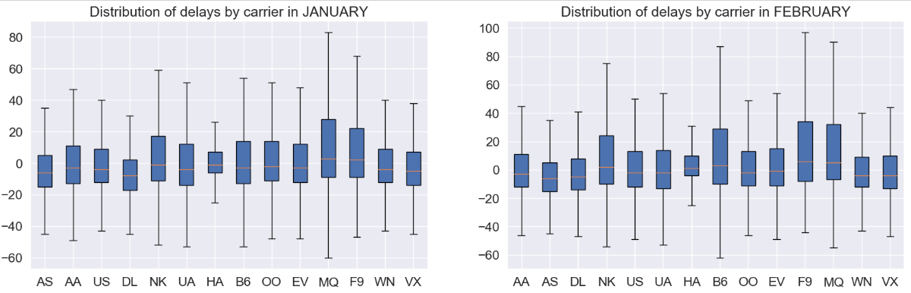
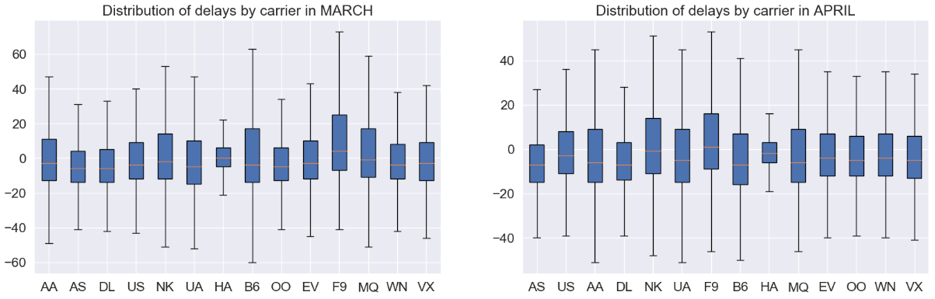
Distribution of delays by carrier
There are some insights that we can figure out by studying each month and comparing each airline carrier but it’s not user friendly. It will take a significant amount of time for any user to derive any insights from these boxplot subplots

Slide 26
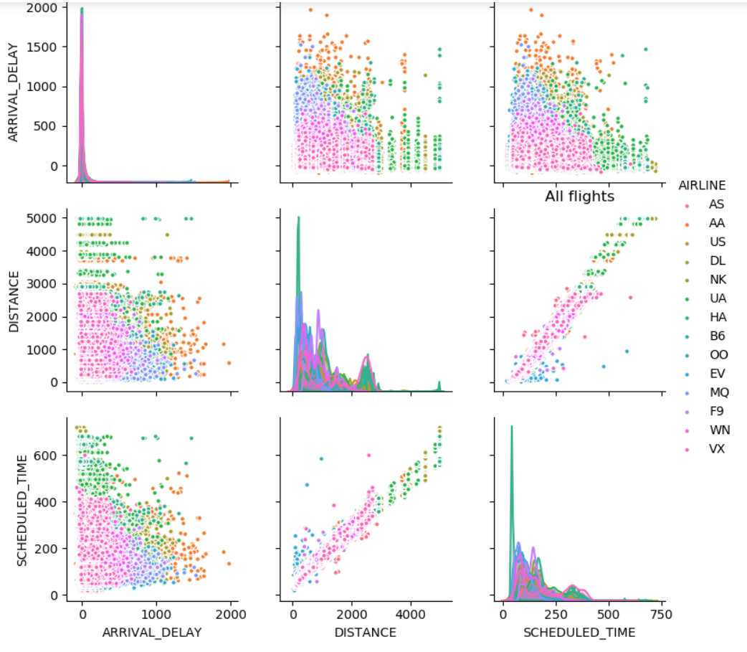
Comparing airline, arrival delay, distance and scheduled time using pair-plot

Slide 27
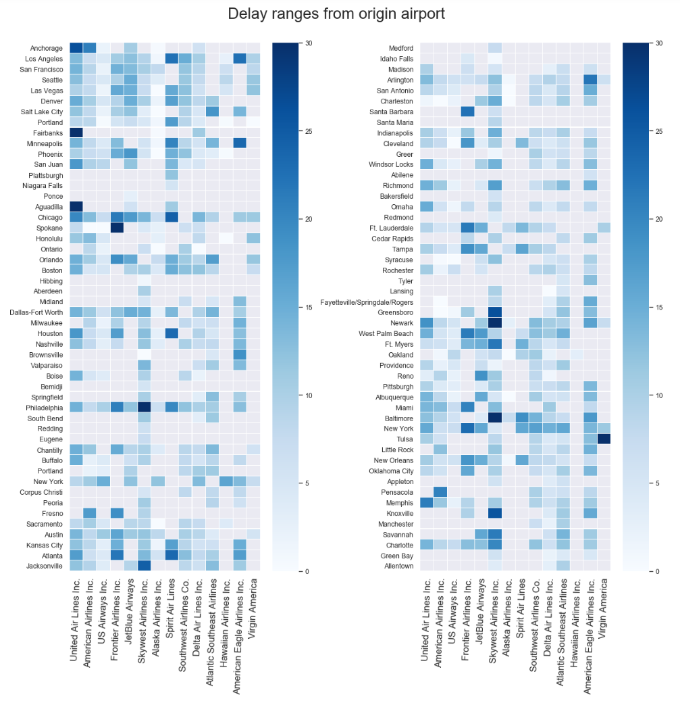

Slide 29
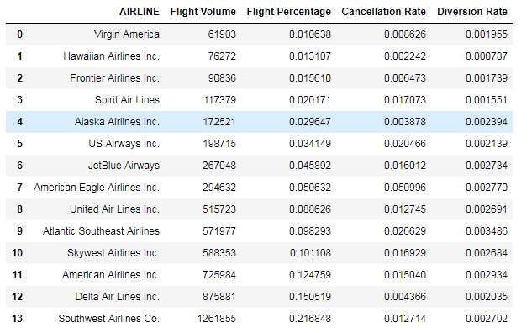
Calculating cancellation, diversion rate and flight percentage for each airline carrier

Slide 30
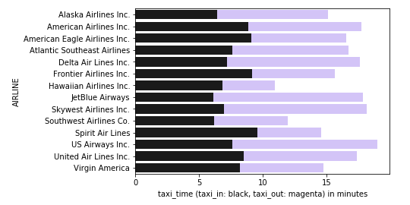
Taxi-in vs taxi-out in stacked bar chart for every airline
It is clearly visible that US airways has largest taxi-in and taxi-out time amongst all the airlines. Hawaiian Airline flights spends least time on taxi-in and taxi-out.

Slide 31
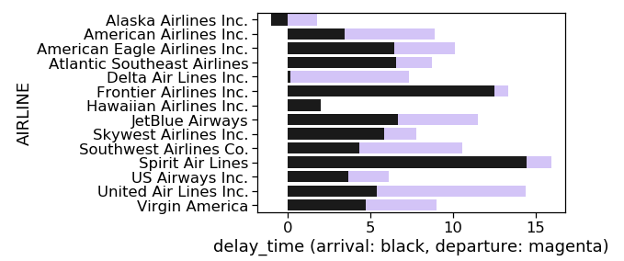
Arrival vs departure delay for every airline
Delta airlines almost has no arrival delay time whereas Alaska airlines has negative arrival delay. That means Alaska airlines always reaches prior to arrival time. Spirit airlines performs worst when it comes to these delays having the highest arrival delay.

Slide 32
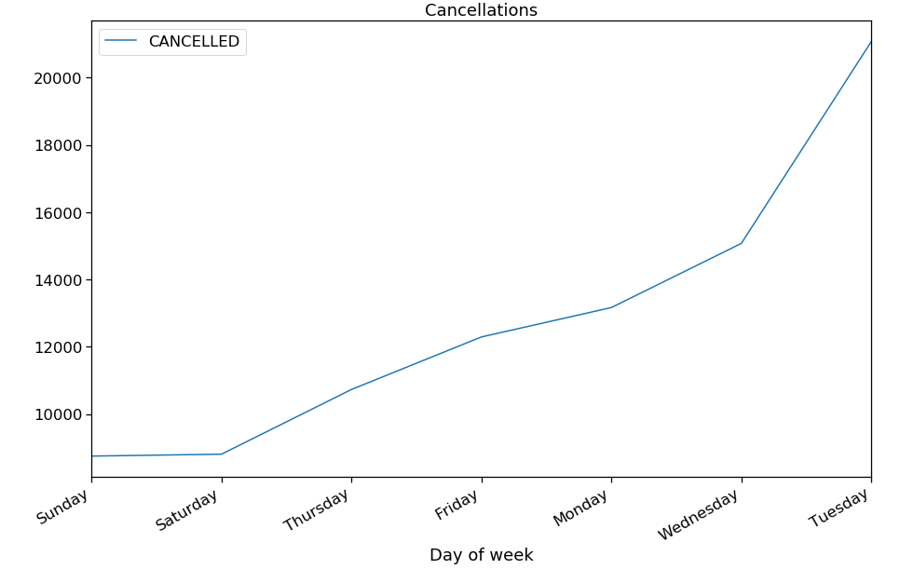
Week by cancellation

Slide 33
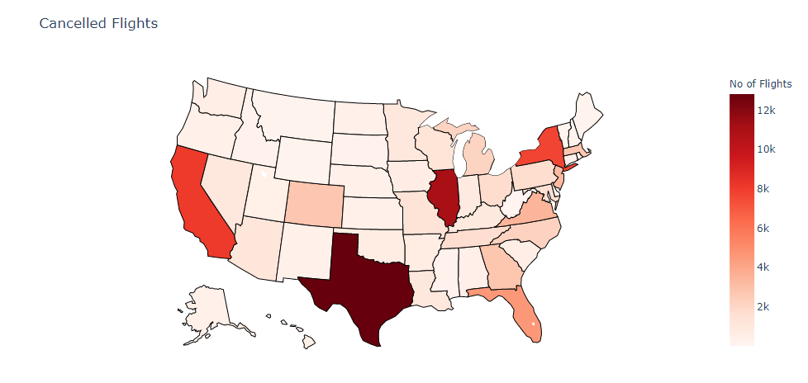
Choropleth for cancelled flights

Slide 34
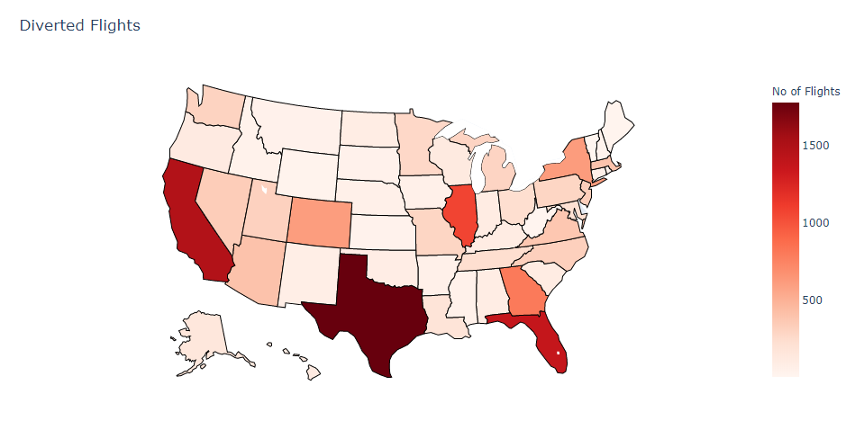
Choropleth for diverted flights

Slide 35
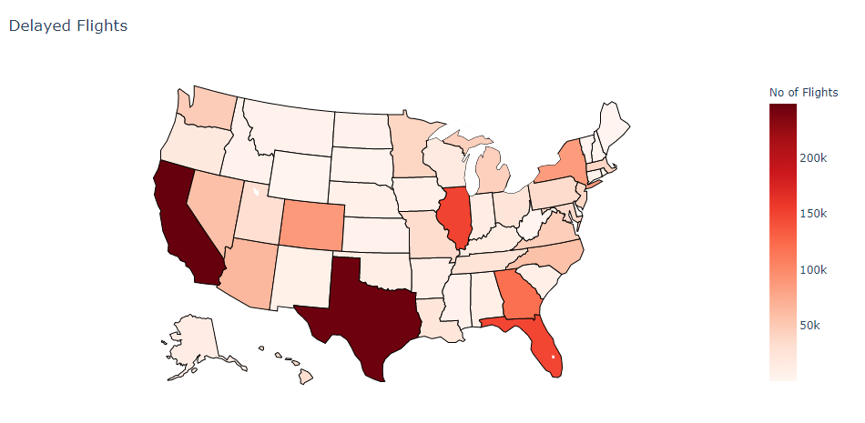
Choropleth for delayed flights

Slide 36
Insight
The visualizations presented clearly shows the airports that need to be avoided for travel during that time period. E.g. Chicago in January
These clearly shows the airlines that are lagging in terms of punctuality and their respective reasons for delays. E.g. American airlines in January.
These visualizations were a deep dive on a limited data to prove our concept, we can change the time period for any period analysis in a future work.

Slide 37
Insight
The visualizations presented clearly shows the airports that need to be avoided for travel during that time period. E.g. Chicago in January
These clearly shows the airlines that are lagging in terms of punctuality and their respective reasons for delays. E.g. American airlines in January.
These visualizations were a deep dive on a limited data to prove our concept, we can change the time period for any period analysis in a future work.

Slide 38
Future work
We want to make our visualizations more interactive, that will allow users to select airports or airlines and time periods to analyze.
A visualization where if you enter boarding and destination airports, it will provide best airlines based on punctuality analysis. (requires algorithms)

Slide 39
Future work
We want to make our visualizations more interactive, that will allow users to select airports or airlines and time periods to analyze.
A visualization where if you enter boarding and destination airports, it will provide best airlines based on punctuality analysis. (requires algorithms)

Slide 40
References
IATA Forecast Predicts 8.2 billion Air Travelers in 2037 https://www.iata.org/pressroom/pr/Pages/2018-10-24-02.aspx [1]
Annual U.S. Impact of Flight Delays (NEXTOR report) http://airlines.org/data/annual-u-s-impact-of-flight-delays-nextor-report/ [2]
Holidaymakers 'waste 16 days waiting in airports over lifetime https://www.telegraph.co.uk/travel/travelnews/7546209/Holidaymakers-waste-16-days-waiting-in-airports-over-lifetime.html [3]
FlightAware MiseryMap https://flightaware.com/miserymap/ [4]
Flight Delay Information - Air Traffic Control System Command Center
Transtats https://www.transtats.bts.gov/Tables.asp?DB_ID=120&DB_Name=Airline%20On-Time%20Performance%20Data&DB_Short_Name=On-Time

